Slide 1

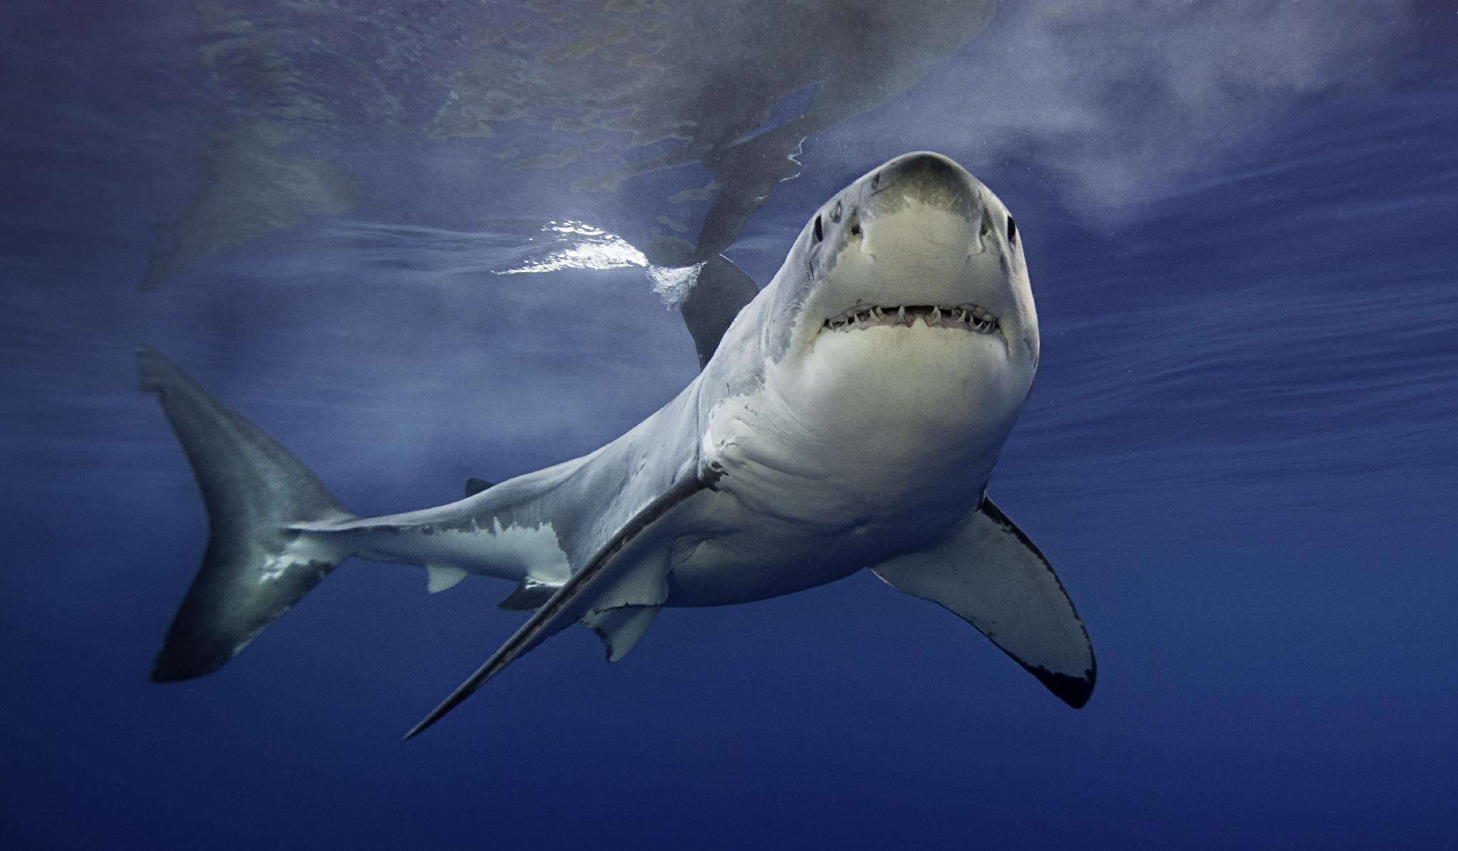

CSC 2026-27 Season
Parent Information

Slide 2



USA Swimming
National Governing Body Sets national rules, standards, athlete safety requirements, and competition guidelines
LSC - Local Swimming Committee
Regional Level Supports and oversees clubs, athletes, coaches, officials & meets within it’s geographic area
Local Swim Club
Provides coaching, training, competition opportunities, and athlete development for our swimmers

Slide 3
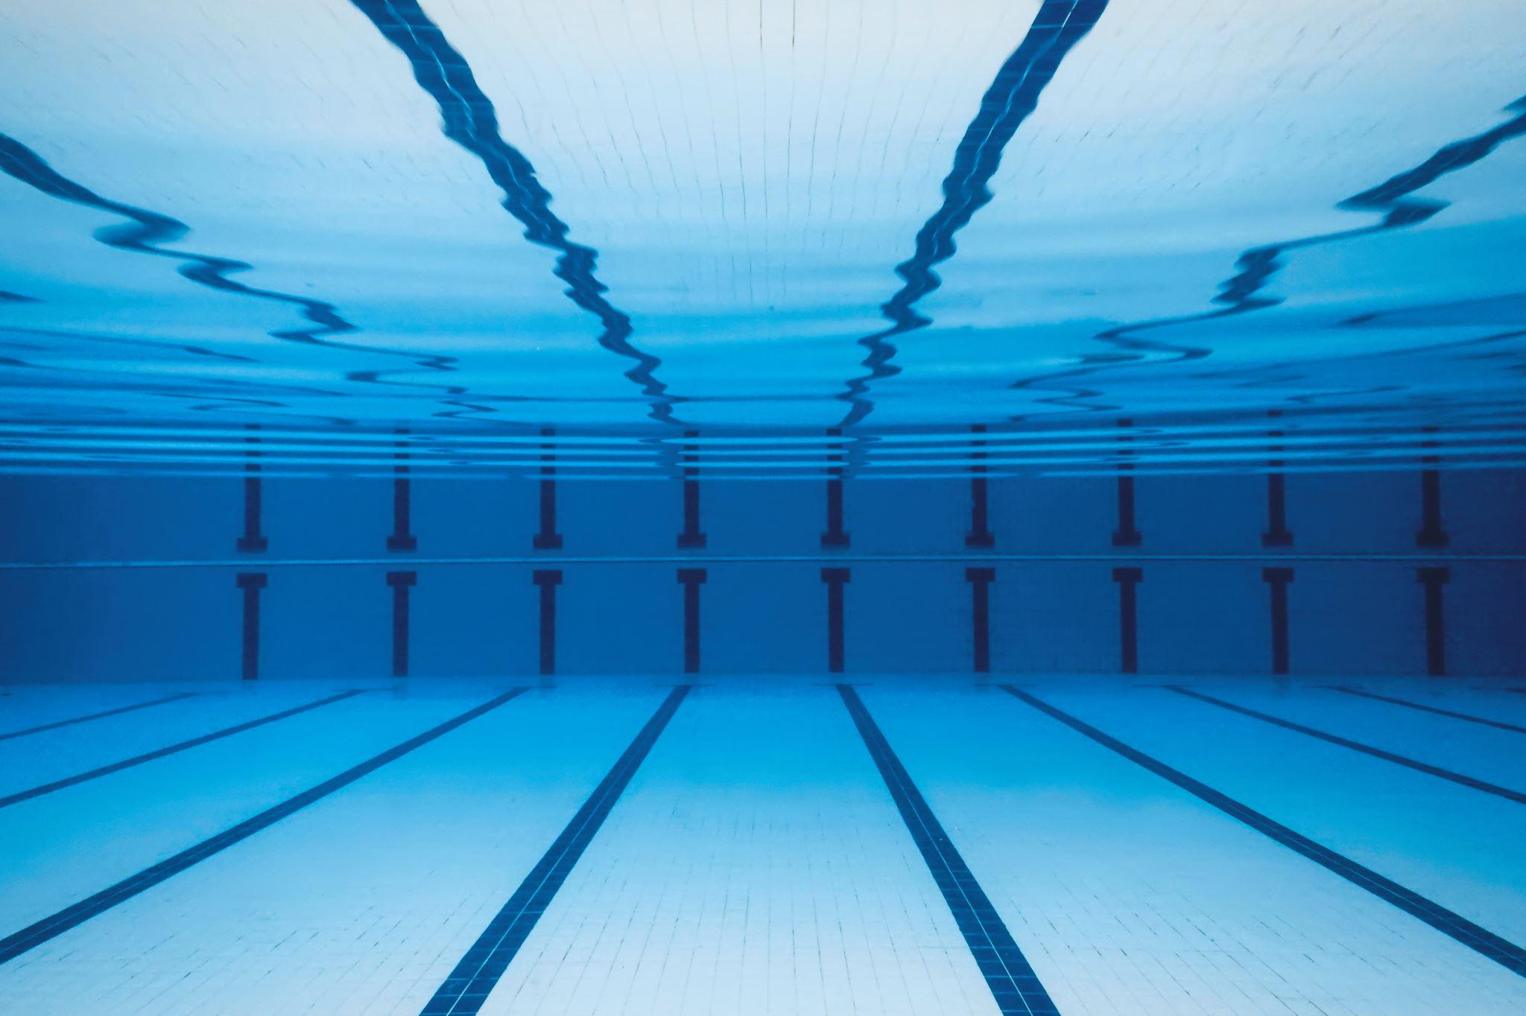

CSC Team Structure
Pre-Comp Teams
Age Group
Performance Track
Pre-Comp 1
AG3
14 and under
Senior Elite
13+ years old
Pre-Comp 2
AG2
14 and under
Seniors
13+ years old
AG1
14 and under
High School Prep
14 + in HS

Slide 4
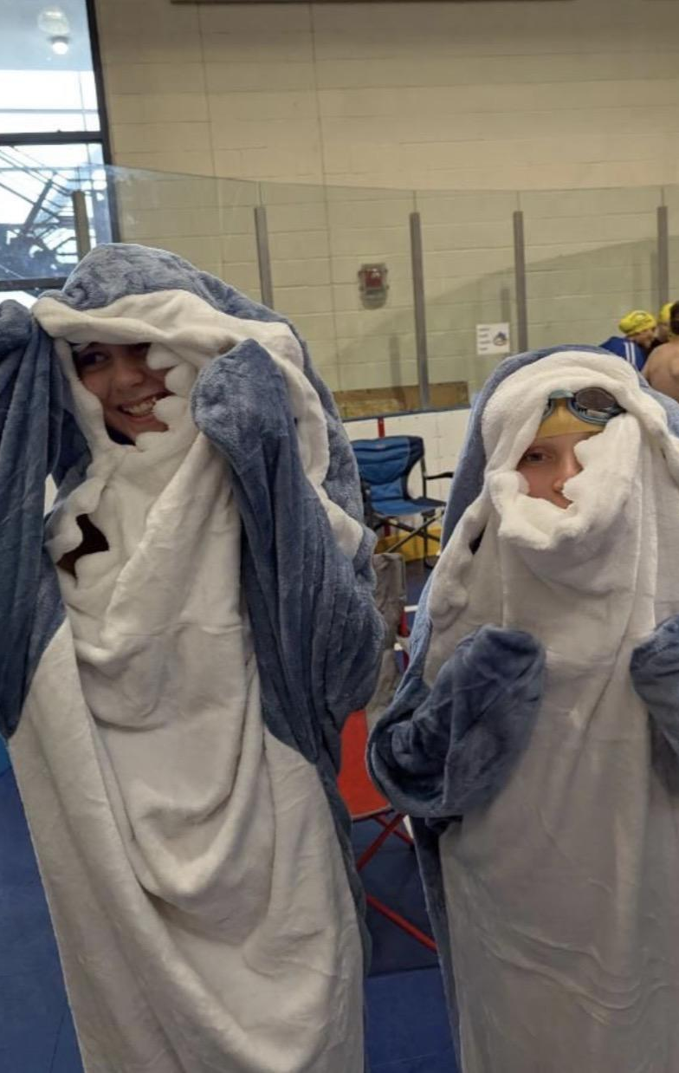
Pre-Comp 1 & 2
Required
  Skill assessment prior to entry
  High school age and younger
  8 week block/reassessment
  Comprehension of four competitive strokes for competitive level
Not required
  USA Swimming membership

Slide 5
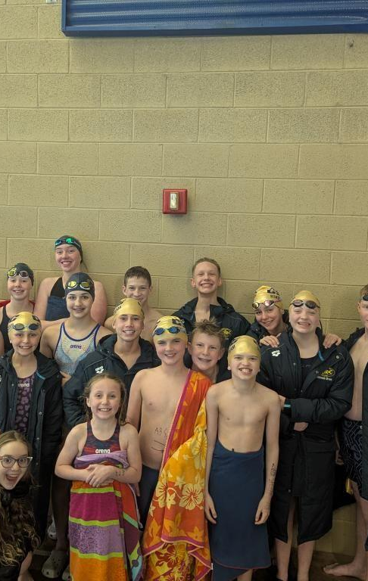
Age Group
AG1, AG2 and AG3
  Required
    USA Swimming Membership
    Family Volunteer requirements 4 sessions per year
  AG3
    Drills
    Kicking
    Interval training/endurance
    Stroke/turn mastery
    Meets: Two (2) annually
  AG2/AG1
    Attends local meets/ IMX or IMR events
    75% attendance
    Championship meet
    test set to move up

Slide 6
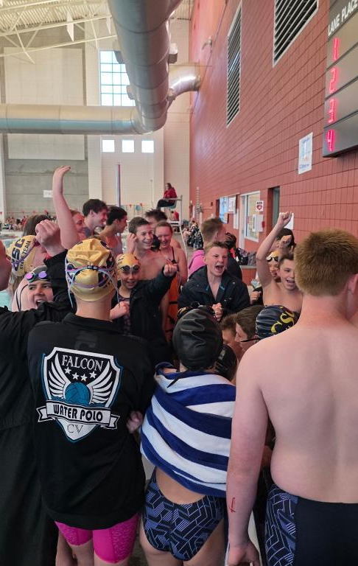
High School Prep
Required
  USA Swimming registration
  14 yrs + and in HS.
  60% attendance
  Attends CSC meets
  Gets HS meets observed
No test set required to be in this group
Offered 4 days a week until HS swim starts then 3 days a week.
Dryland 2 days/week

Slide 7
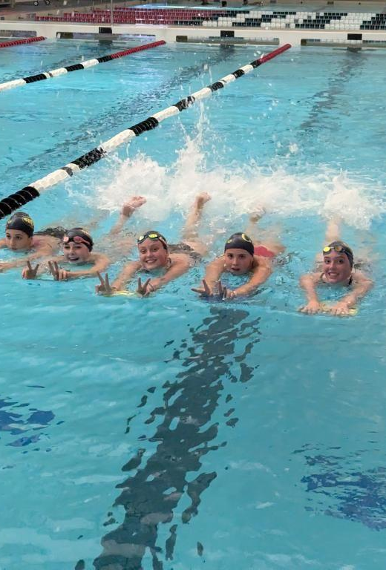
Senior’s (SRs)
Required
  USA Swimming Registration
  Coach Recommendation
  Coach/Swimmer/Parent contract of expectations
  Focus on Advanced training
  6 practices offered weekly
  Dryland 4 days/week
  80% practice attendance requirement
  Local and State meets required
  HS meets observed
  IMX events
  Family Volunteer requirements 8 Session per year
  Two (2) 13/14 BB motivational times

Slide 8
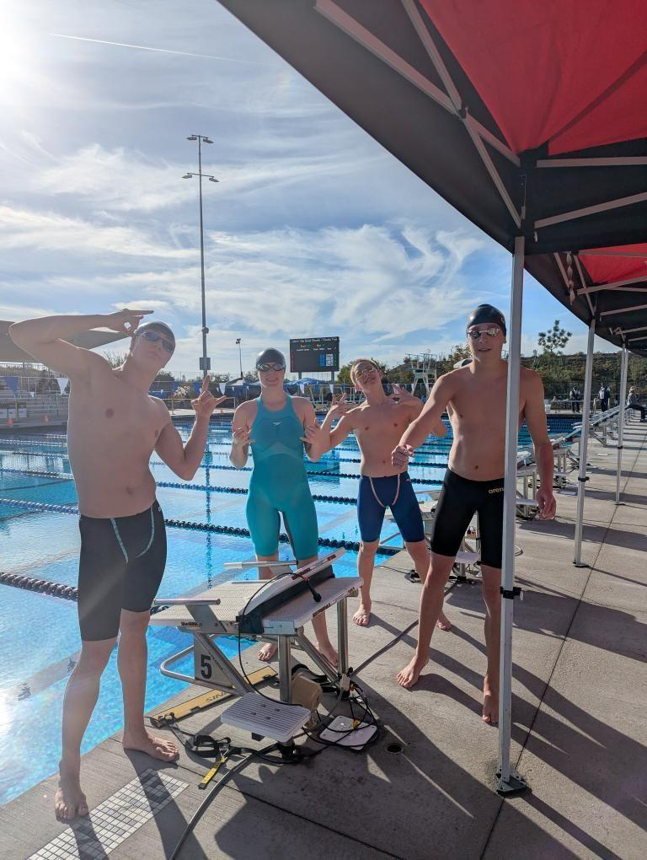
Senior Elite (Elite)
Required
  USA Swimming Registration
  Coach Recommendation
  Coach/Swimmer/Parent contract of expectations
  Focus on Advanced training
  8 practices offered weekly
  Dry land 4 days/week
  85% practice attendance
  Local and State meets required
  HS meets observed
  IMX events
  Family Volunteer requirements 8 Session per year
  Two (2) 15/O BB motivational times
  Travel meets TBA
  Demonstrates leadership qualities on/off pool deck
  Helps younger swimmers

Slide 9
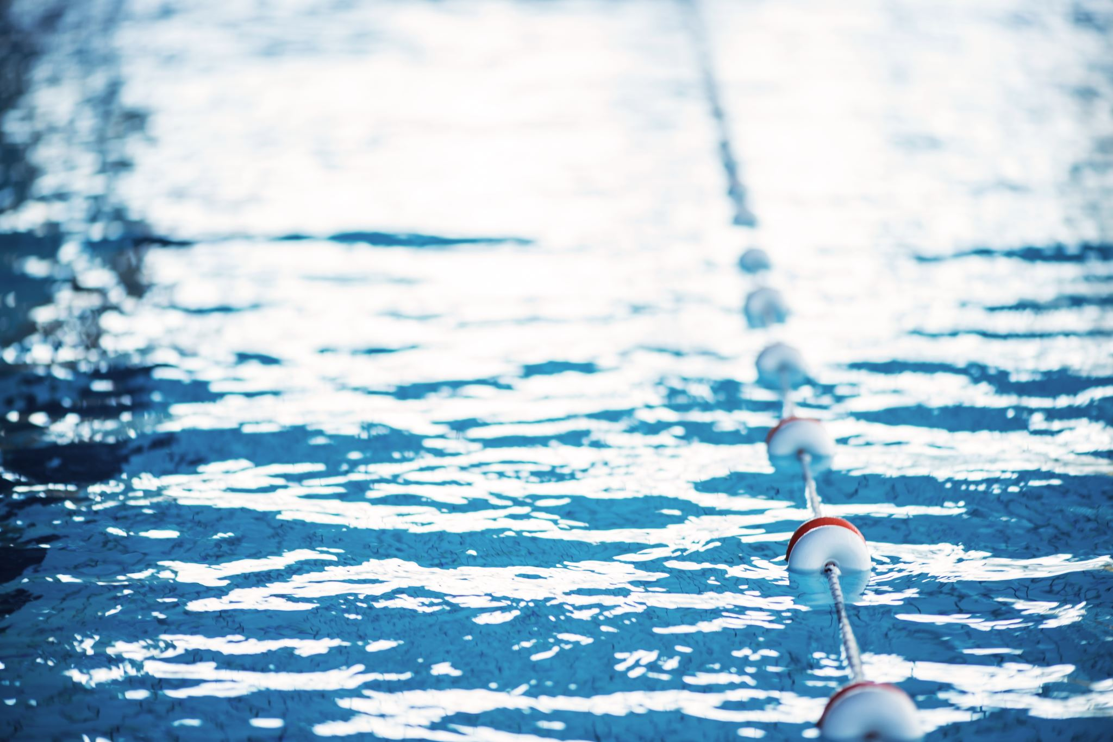
Registration fees
USA Swimming Registration-$95
  Mandatory for all Competition teams
  Club will register and charge account for all returning swimmers - November.
  First time registrations - set up by parents
CSC Registration Fee-$75
  Administrative costs
CSC Gear
  Team Suit
  Team Shirt
  (Team Cap can be purchased separately for $10)

Slide 10
Financial
Payments
In full or pay billed monthly on the first of each month for 11 months.
Fundraising
Cancelation/Pause
Email only
1 month Prior.

Slide 11
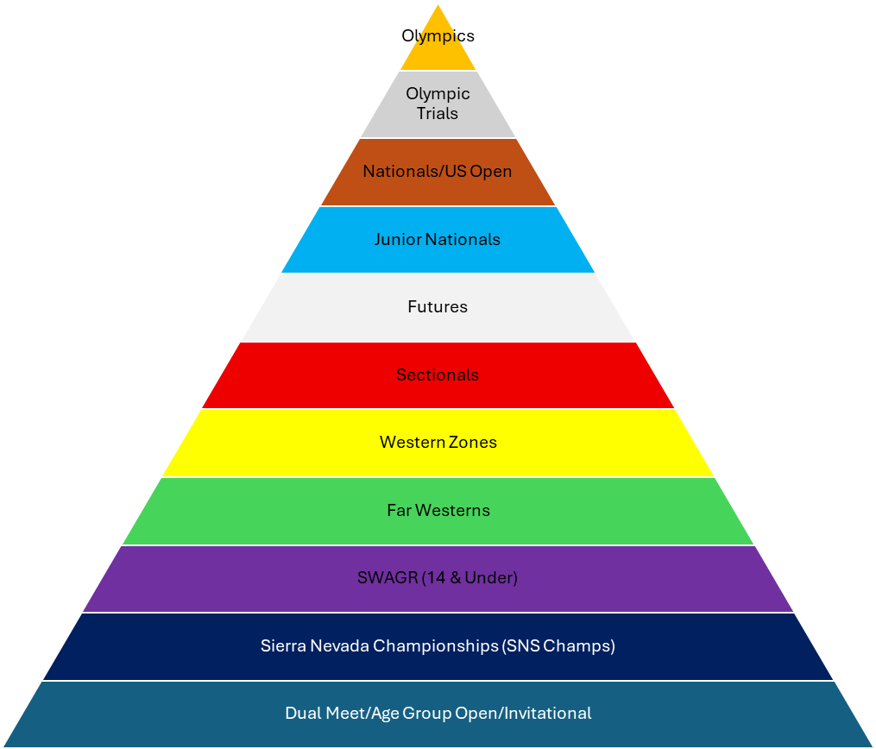
UTAGS/SR State
Local swim meets / Invites / Duel meets / Intersquad

Slide 12
Meet costs
Individual Meet Fees.
    Set by the host club.
    Paid by CSC
  scratches: Contact coach prior to submission to LSC
Coach Fees
  travel cost
  coach hours
Travel Meets
  Actual costs (travel cost plus coach’s hours)
  divided by the number of swimmers attending the meet
  Capped at $500 per meet per family
CSC and SUSA Swim meets incur a $10 coaching fee

Slide 13
Safe Sport
Cedar Swim Club follows USA Swimming MAAPP policies
No one-on-one unsupervised interactions
Electronic communication must include parents
Coaches do not arrange overnight accommodations
Proper supervision during team activities
Reports may be made to:
  Club Safe Sport Coordinator - Cassey Woodall
  Head Coach - Kirstin
  USA Swimming Safe Sport
Annual Safe Sport Due December 2026 / Concusion

Slide 14
Illness / Injury
DO NOT COME TO PRACTICE IF:
Fever (100.4°F or higher)Vomiting or diarrhea
Persistent cough
Sore throat with fever
Unexplained rash
Conjunctivitis (pink eye)
Flu-like symptoms
Any diagnosed contagious illness
Any condition for which a healthcare provider has recommended isolation Return-to-Practice Guidelines A swimmer may return to practice only when:
Fever-free for at least 24 hours without the use of fever-reducing medication
Vomit-free and diarrhea-free for at least 24 hours
Significant improvement in respiratory symptoms
At least 24 hours after beginning prescribed antibiotics, if applicable
Cleared by a healthcare provider when required

Slide 15
Athlete Expectations
I will respect my coach and fellow swimmers at all times
I will respect for all facilities and equipment(including locker rooms) used during practice, meets, and team travel
I will be on time. Which means: in the water, ready to practice at the specified time
I will refrain from foul language, including racial slurs, violence, and any activity deemed illegal, dishonest, or offensive
I will be respectful of my teammates personal space
I will demonstrate good sportsmanship at all meets, practices, and events

Slide 16
Parent Expectations
Volunteer requirements
  Minimum 20 volunteers to effectively run a meet
    timing, officials, hospitality
  Requirements are family based and determined by the highest group requirement if you have multiple swimmers
  Volunteer buyout $30/session
  Tracked through Commit
Please wait to talk to the coach before or after practice. Allow them to coach
Model good sportsmanship and behavior for our team
Give your swimmer loves and hugs. They put more pressure on themselves. Please do not add to it.

Slide 17
Officials
Training & Certification is through USA Swimming
Register with the LSC
Training required
  on deck shadowing
  Written test
Safety requirement are mandatory
  Athlete Protection Training
  Background Check
  Concussion Protocol Training

Slide 18
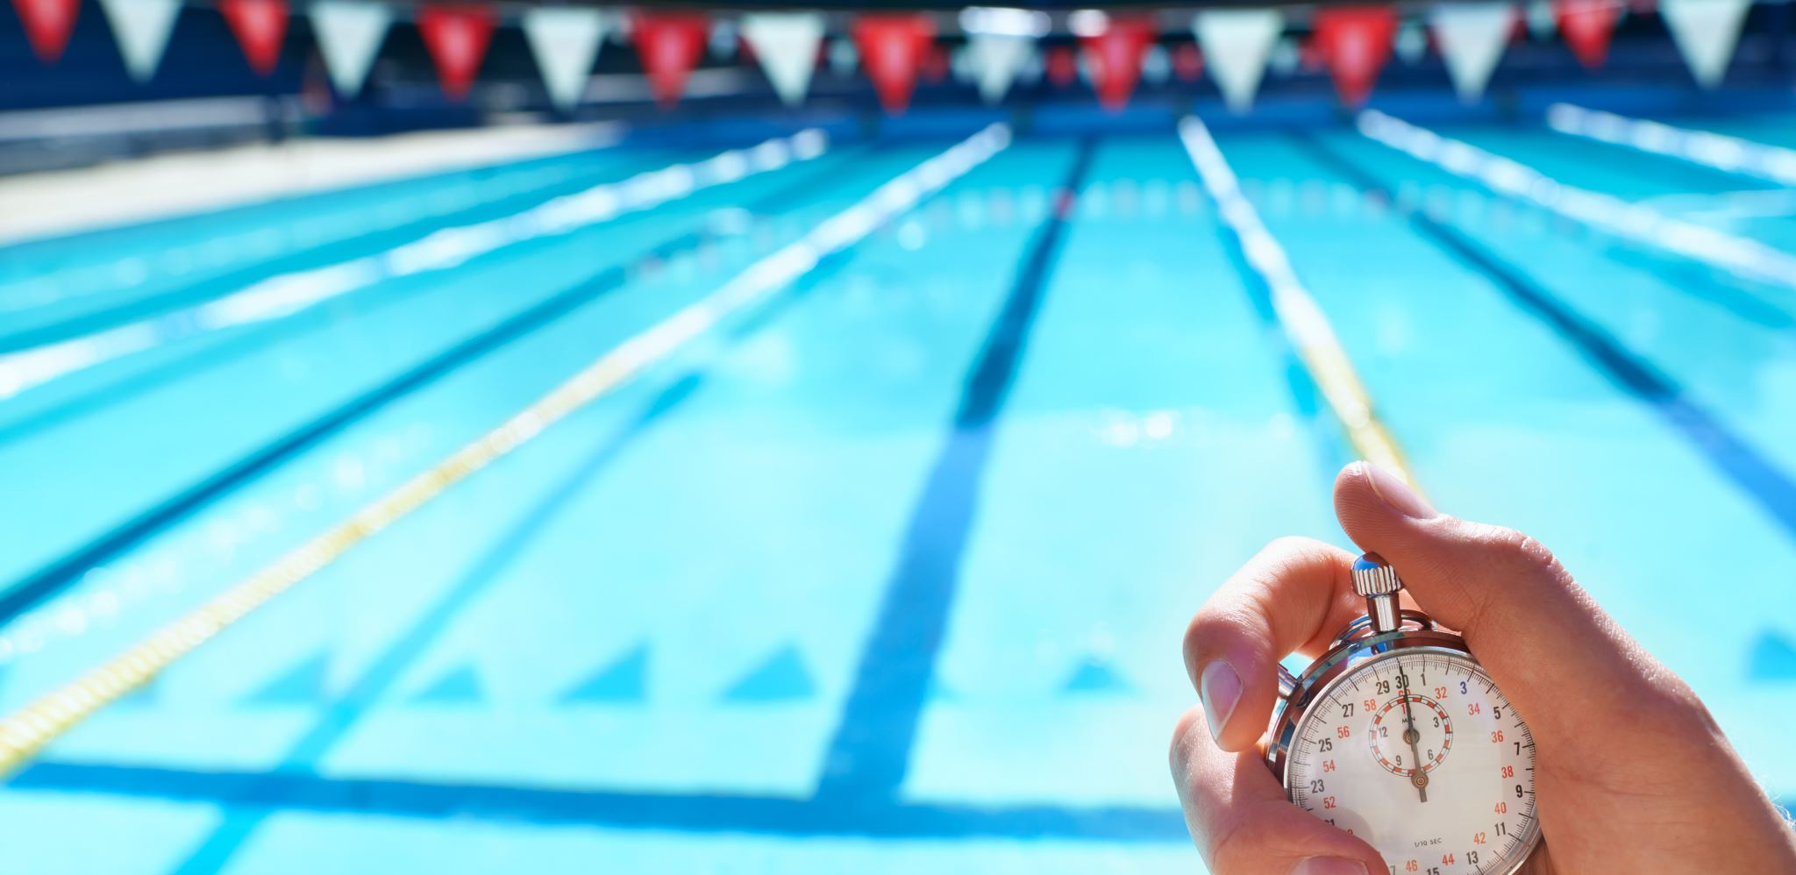
Arena Sponsored Club
Benefits:
  Value in kind (VIK) that can be used by the club for equipment, apparel
  VIK for each swimmer qualified for State meets or higher
  20% discount for all Arena equipment/apparel purchased through our vendor (Poco Loco Swim Shop)
Required:
  1 Arena Suit purchased per year per swimmer
  Only Arena branded suits (except Tech suits), caps, and branded team apparel at swim meets

Slide 19
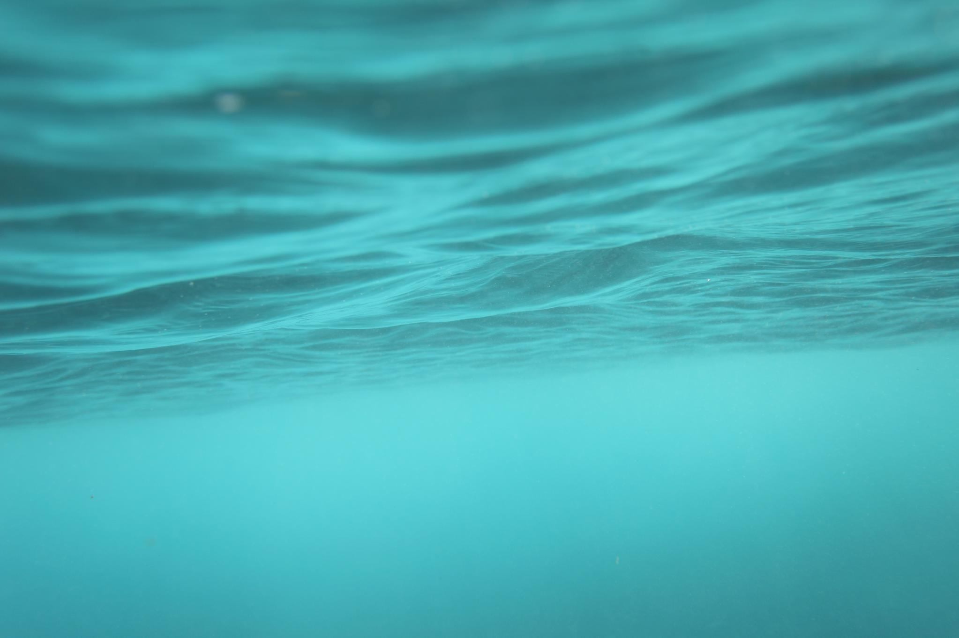
Suit fitting/equipment Purchase
Thursday Sept 8th from 4:30pm – 6:30pm
  Pre-Comp 1 & 2, AG 1, 2, 3 4:30 start
  SR, Elite and HS P after swim
  NO DRYLAND all groups.
Poco Loco will be onsite
Suit Fitting, practice and big suits
Equipment order
Order and size jackets, parkas

Slide 20
Poco Loco Swim Shop
https://www.pocolocoswims.com/teams/cedar-swim-club/
Discount Code: CSC20
Enter at check out
If purchasing a tech suit, contact the store directly. They will help with sizing
  Tech suits are different for 12U vs 13+
Team store will have other gear options for practice.

Slide 21
Swimmer’s Equipment
Gear | Pre-Comp | AG3 | AG2 | AG1 | Seniors/ SR Elite | HS Prep
CSC Cap | X | X | X | X | X | X
Goggles | X | X | X | X | X | X
Competition suit | X | X | X | X | X | X
Water Bottle | X | X | X | X | X | X
Snorkel |  | X | X | X | X | X
Paddles |  |  |  | X | X | X
Fins (arena) |  |  |  |  | X | X
Stretch cords |  |  |  |  | X
Drag suit/socks |  |  |  |  | X

Slide 22
Short Course Season Meets
9/11 CSC Blue / Gold intersquad (all swimmers) @ SUU
9/25-26 SUSA Fall Fling @ SHAC
10/23-24 SUSA Spooktacular @ WCCC
11? CSC Turkey? Last chance for SR Champs
12/3-6 UT SR Champs Q meet @ UT Tech
12/11-12 SUSA Christmas Chaos @ WCCC
1/15-16 Stingrays New Years Invite @WCCC
2? CSC - last chance @ SUU
3/3-6 UTAGS Q meet @ UT Tech
Long Course meets TBA on the website

Slide 23
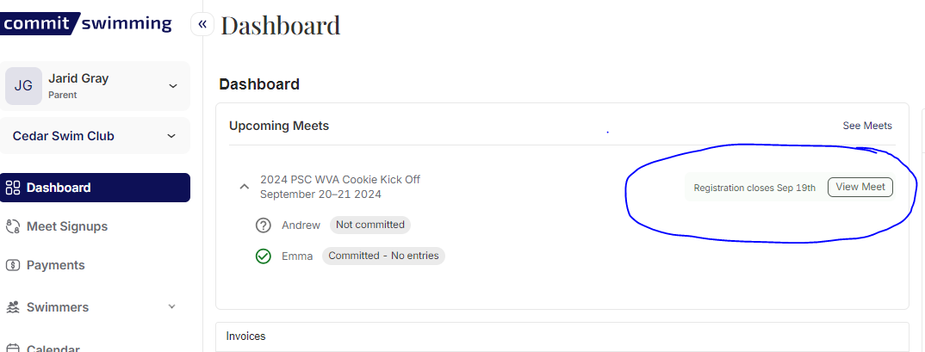
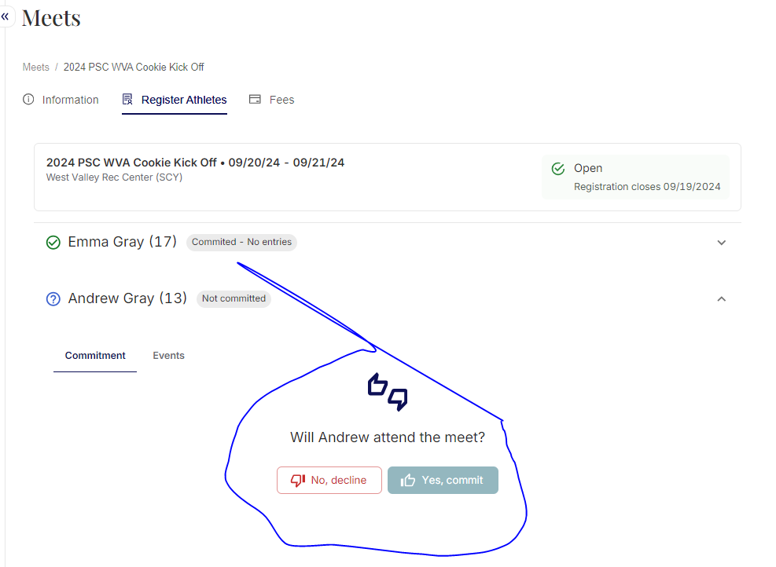
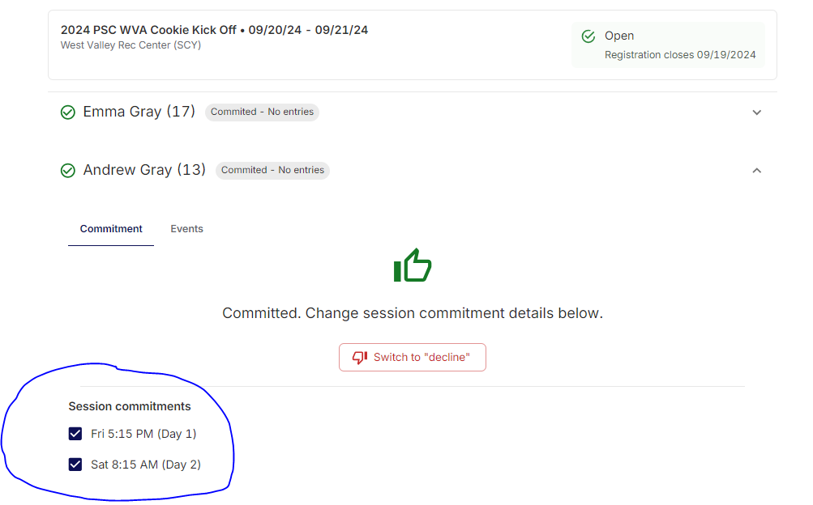
How do I…Sign up for Meets

Slide 24
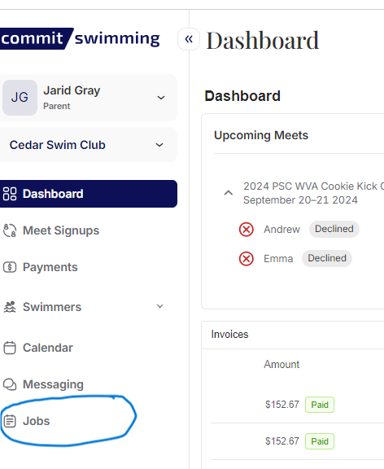
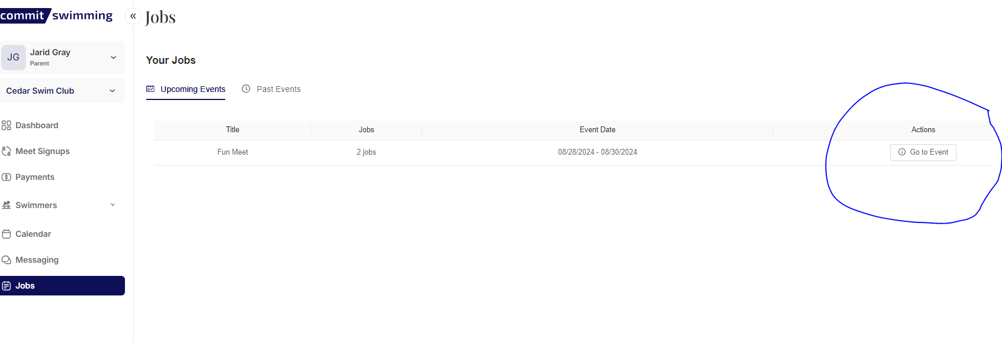
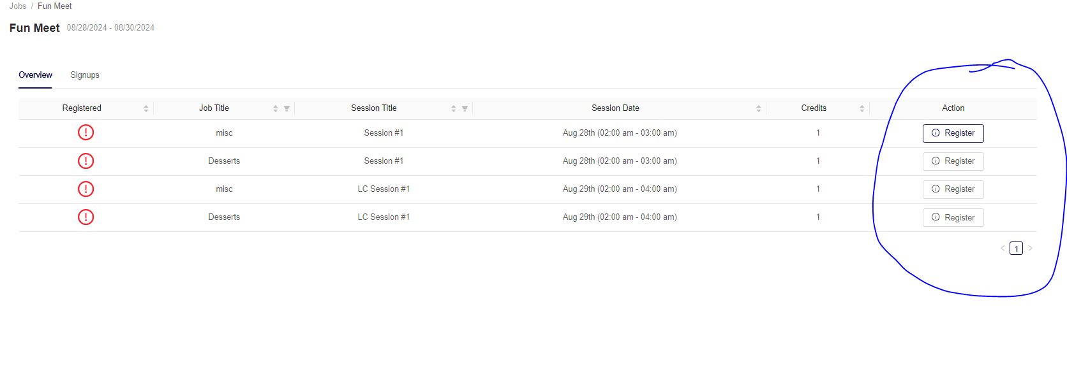
How do I…Sign up for Jobs

Slide 25
Websites and APPS
Commit Login
  https://team.commitswimming.com/sign-in
Team website
  https://www.cedarswimclub.com/
USA Swimming
  https://hub.usaswimming.org/landing
Utah Swimming
  https://www.gomotionapp.com/team/lscuts/page/home
Meet Mobile APP (Used for Swim meets)
Swim cloud
SwimIO

