Slide 1
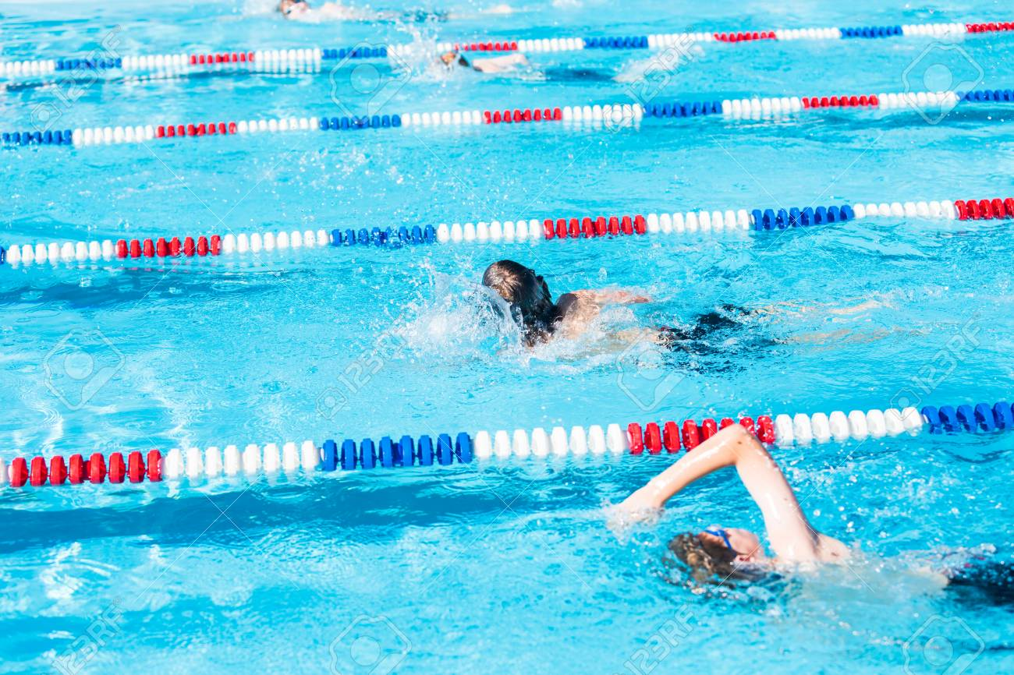

Your First Swim Meet
A Parent Guide

Slide 2
Preparation
Don’t skip practice.
Get a good nights sleep.

Slide 3
What to bring/pack
Clothing for the weather conditions.
Athletes need warm muscles. Clothing must keep that in mind.
Be prepared for hot, cold, rainy – it’s Florida and we all know weather can change rapidly!

Slide 4
More what to bring
Pack a “swim bag” the night before.
Swim suit.
Goggles and team swim cap.
Towels (they get wet quickly).
Colder months add: blanket, swim parka, socks, warm shoes, sweatshirt, pants, etc.
Sunscreen.
Chairs for you and your family. The team usually sits under pop-up tents together. It adds to the fun of the day having the kids/parents socialize during the down times. Cards, games, books, etc. are also a good way to pass the time in between events (races.)

Slide 5
More stuff!
Pack a small cooler with snacks and drinks. Fresh fruit, granola bars, fruit bars, etc. are good choices. Swimmers will get hungry after some of their events, but you won't want something heavy on their stomach. Keep the snacks simple, healthy, and easy to digest.
Think simple carbs!
WATER!!! Don't forget your water bottle with water and bring a sports drink.
Stay hydrated. Sipping water throughout the day will go a long way to keep your body in top form.
If you are thirsty, then you are dehydrated, and you will tire more quickly.

Slide 6
Nerves
Being nervous is normal.
Eat breakfast. Keep it light and easy to digest (no protein).
Carbohydrates will fuel your body and last longer: bagel with a little cream cheese, oatmeal with fruit, whole grain toast, fruits, juice, etc. are all good choices.

Slide 7
Heat sheet
A “heat sheet” is a swim meet program.
Two methods to get yours…
Electronically (email and/or website).
Purchase at the meet.
This is the list of all the events, each heat, and each swimmer's lane. It's your program guide for the entire day.
You’ll see parents writing the information for their children's races on the kids' hand, arms, or leg. It's not a bad idea to do this, so bring a Sharpie pen.
It’s best to do this prior to warm ups.

Slide 8
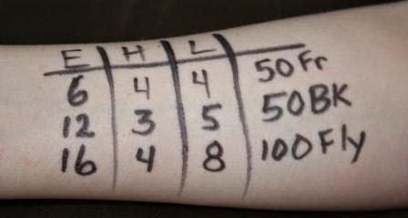
Here is how to do it
Example: Your has three events in one day: Event #6 - 50 Free, Heat 4, Lane 4 and Event #12 – 50 Back, Heat 3, Lane 5 and Event #16 – 100 Fly, Heat 4, Lane 8.
This is how you would write that on the arm:

Slide 9
Arrival at the pool
Arrive in plenty of time to find…parking, team tents, bathrooms, etc.
Meets not at our home pool – this process will/can take much longer than expected.
Once your camped out – find your coaches!
Coaches will let the swimmer know when warm up will begin, and where to gather.
Be on time for warm up. It’s essential to your swimmers success.
Coaches will not make the athlete “too tired” during warm up.

Slide 10
WARM UP, AND THEN WHAT?
Coach will direct warm up.
Once warm up concludes…
Get dry, stay warm, and hydrate.
Hang out with your teammates, and wait for the first event.
It is not the coaches responsibility to get swimmers to the blocks.
Keep track of the events and go to the starting block well before your event.
Parents are not allowed behind the starting blocks (or starting end).
No photography from behind the blocks.
Parents are encouraged to cheer loudly for any and all swimmers from our team!
Stay out of the way so meet “officials” (referees) can walk.

Slide 11
The race (event)
Swim your race!
“Fly Over Starts” = after the race stay in the water, move to one side, and hold onto the wall.
Exception is Backstroke.
After your race, go talk to your coach first. He/she will tell you what you did well and what you can still work on. This is all part of learning how to race.
Then talk to parents, quickly before doing a “warm down” per coach instructions.

Slide 12
After the race
Parent to athlete – “Congrats! Great job! I love you!”
Swimmer does a “warm down”.
Swimmer returns to team area, hydrate and snack (if time).
Relax and wait for your next race.
Congratulations! You've worked hard to get to this point.
Each time you race, you'll figure out things that make you a better swimmer, a stronger athlete, and a more focused person.
Be proud and have fun!

Slide 13

results
Race results. Usually post a hard copy at the venue.
Meet Mobile phone app.
Our website once available electronically.

