Slide 1

Welcome to LAMVAC Swim Club
New Member Orientation

Slide 2
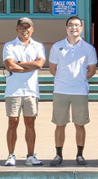
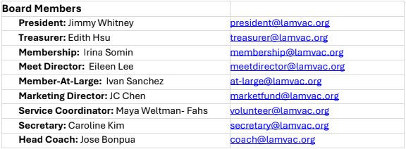
LAMVAC Team
Head Coach: Jose Bonpua (left). Leads LAMVAC since 1998
Coach Jose trains Junior and Senior groups
Head Age Group Coach: Jonathan Ho (right)
Coach Jon trains Tiger Sharks, oversees Piranha and Tadpoles

Slide 3
Swim Groups and Promotions
Progression: Tadpoles → Piranha → Tiger Sharks → Juniors→ Seniors
Tadpoles is our pre-competitive group
Promotions are based on coach evaluation, readiness, and commitment
Promotions are individual based on performance during regular practice

Slide 4
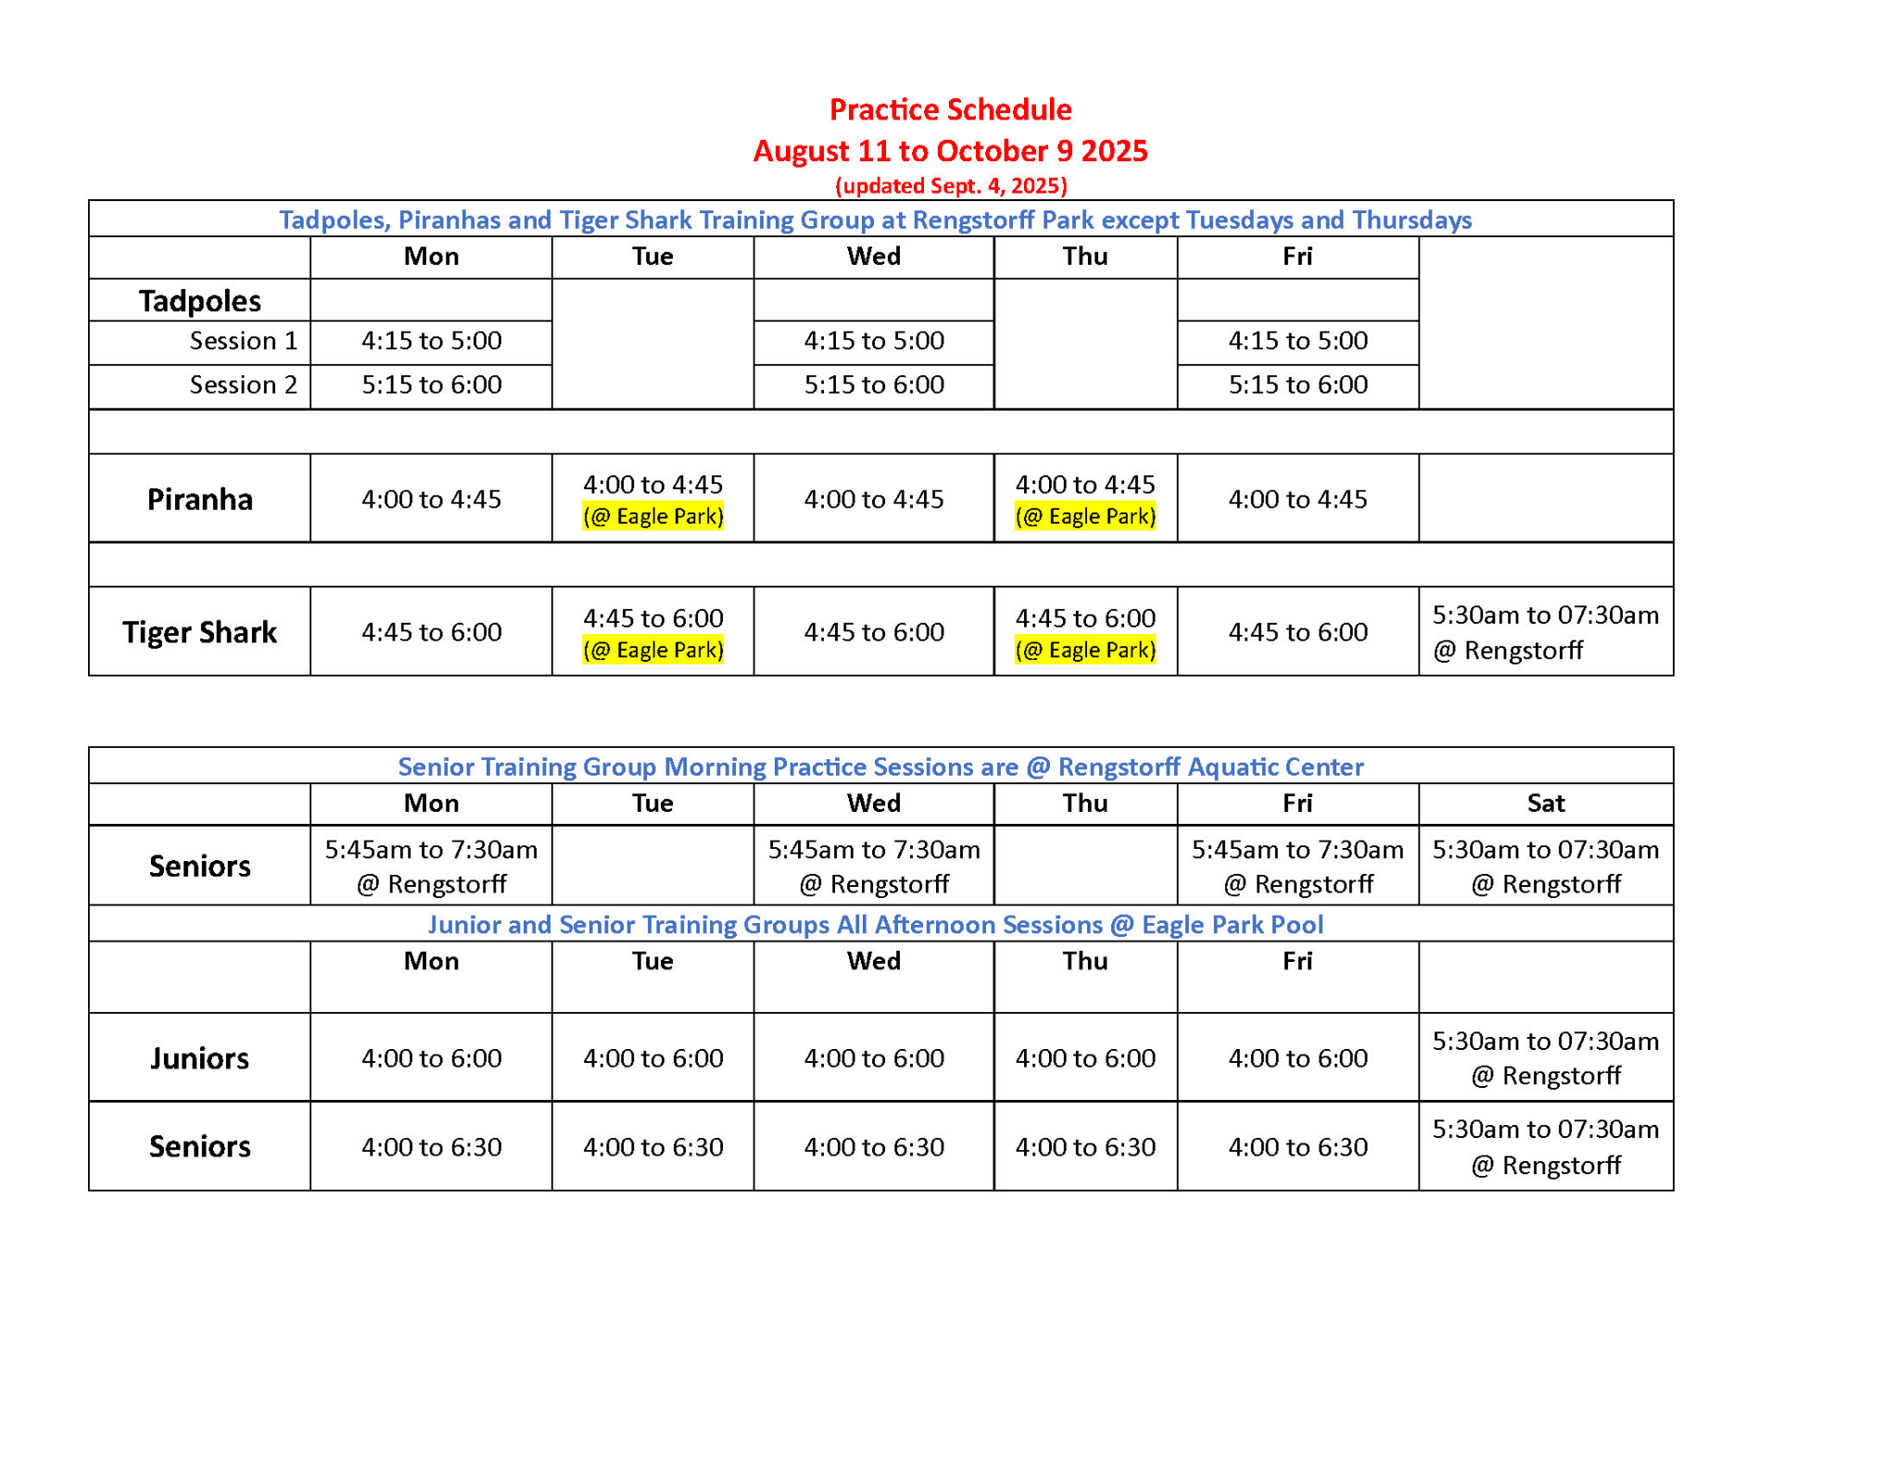
Swim Schedule
The schedule is current, please disregard the dates at the top
Updates to schedule and facilities are posted on https://www.lamvac.org/news-updates and through the WhatsApp group

Slide 5
Volunteering
LAMVAC is a nonprofit organization powered by parents. Every family contributes to the team’s success!
All competitive swimmer families have an obligation of 25 service hours per season
Ways to earn volunteer hours:
  Two annual home meets in Spring. Minimum 13 hrs required per family at home meets. $50/hour penalty for unmet hours
  Club events (team picnics, winter party)
  Non-LAMVAC hosted meets as lane timers (look out for coach’s announcements)
  Become a USA Swimming Stroke and Turn official
  Join LAMVAC Board of Directors (elected at the annual meeting in August)

Slide 6
Competitions
Optional but encouraged for tracking progress and obtaining official swim times
LAMVAC hosts two meets annually + one intrasquad meet
Standard meet structure:
  2-day events, Sat-Sun
  13 & over - morning session, 11/12 & under - afternoon session
  Swimmers usually participate in 2-3 events per day
Coaches announce when meets are open for sign up. You can sign up directly or through a coach.

Slide 7
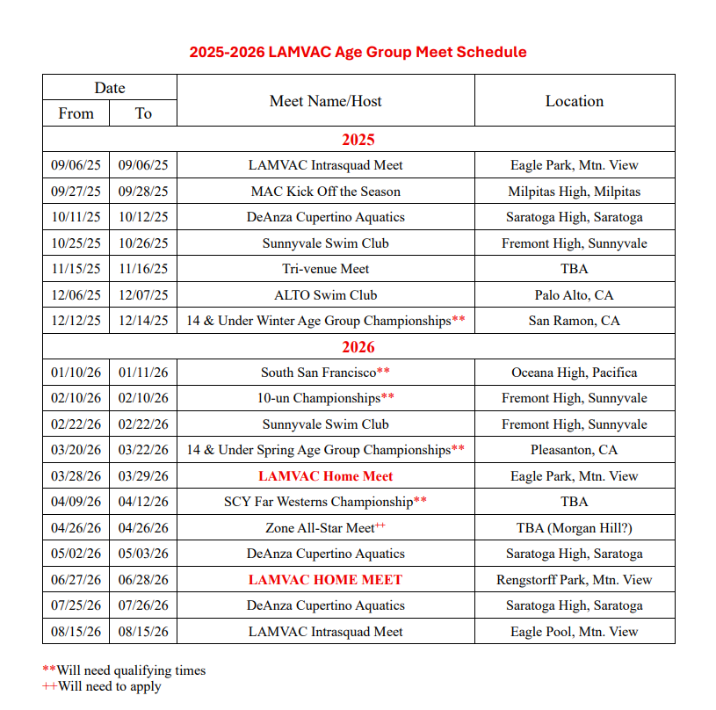
Competitions
Full schedule available at https://www.lamvac.org/meet-schedule

Slide 8
Meet Logistics
Arrive 10–15 minutes before warm-up time
Bring team gear, snacks, water, and layers
Bring one towel per event + warm-up, and anything else your swimmer needs to stay warm between their events
Coaches guide swimmers through warm-ups and races
More information available at https://www.lamvac.org/meet-faq

Slide 9
Payments & Fees
Annual fee for competitive groups, Tadpoles exempt ($235)
Annual USA Swimming registration ($90)
Monthly membership fee for all swimmers (depending on the group)
Annual Swimathon fundraiser (voluntary, highly encouraged)
Meet fees: $10–20 per meet and $4–5 per event
Pausing membership (due to injury, travel, personal circumstances) will replace monthly membership fee with flat rate of $35 for each month of not swimming
This is a summary of all potential fees you can incur throughout a swim season

Slide 10
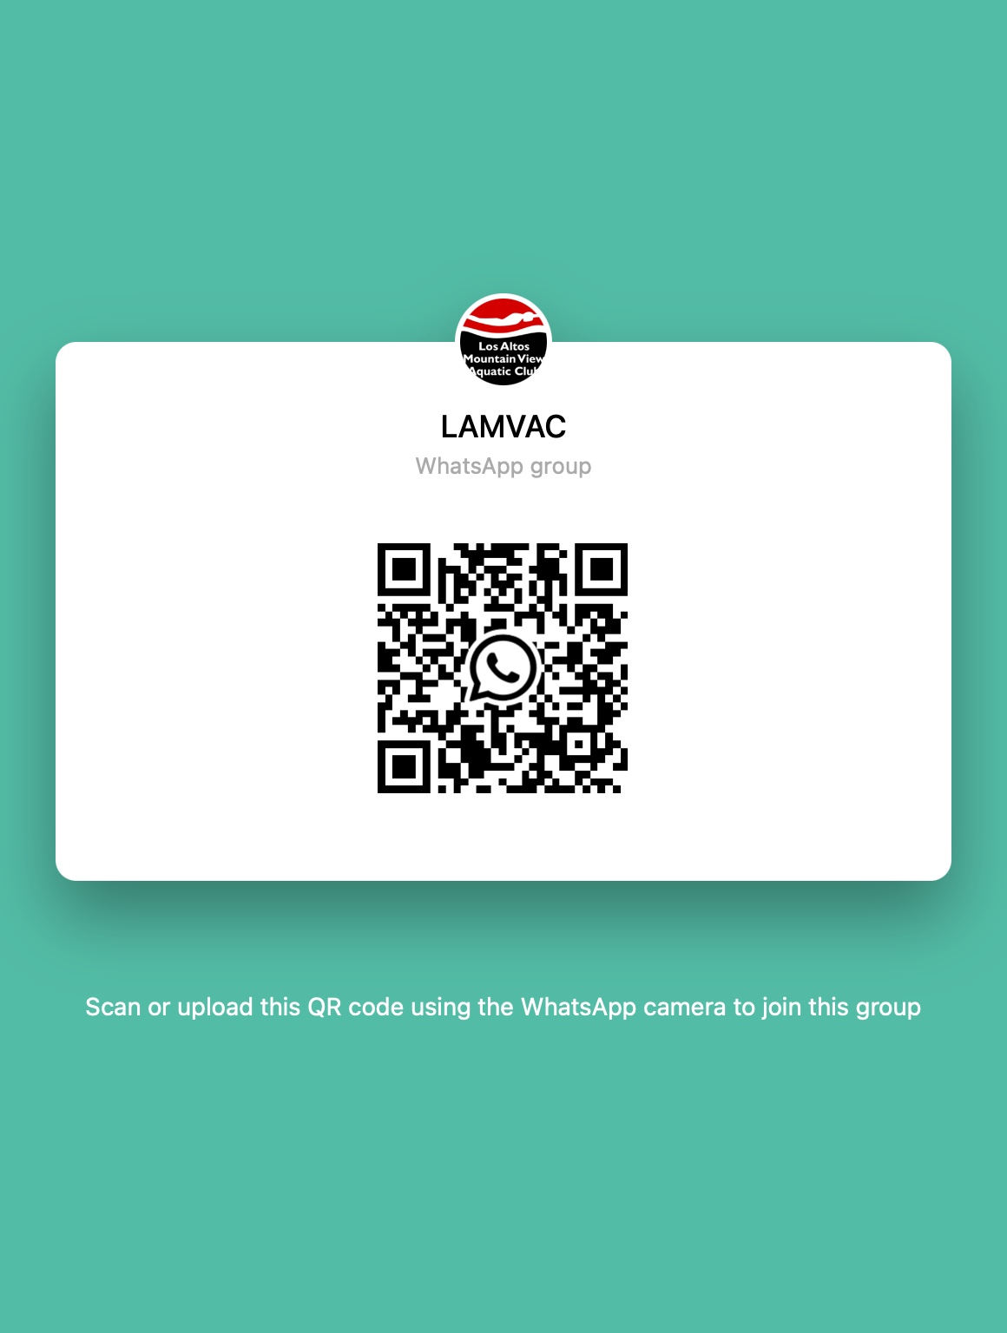
Summary
LAMVAC thrives on partnership: Coaches + Parents + Swimmers
Stay engaged, volunteer, and communicate
Visit lamvac.org for schedules, payments, and volunteer sign-ups
Join our WhatsApp group - QR code below
Team store (one cap and t-shirt provided for competitive groups)
Contact: membership@lamvac.org

Slide 11
Thank You & Welcome Aboard!
Together, we make waves 🌊

Slide 12
Appendix

Slide 13
Registration Groups Avg Age
AVERAGE of Age
Tadpoles | 6-9
Piranha | 8-12
Tiger Sharks | 9-13
Juniors | 12+
Seniors | 14+

